Slide 1

Codecademy Case Study
Lifion HCM Modular Criteria

Slide 2

Table of Contents
Background and Context | 3
Feature Discovery | 4
Feature Ideation | 5
Roadmapping | 6
Building the Feature | 7
Results | 8
Lessons Learned | 9
Appendix I: Original Criteria | 10
Appendix II: Modular Criteria | 11
Appendix III: Implementation | 12

Slide 3

Background and Context
In an attempt to consolidate hundreds of legacy HCM applications owned and managed by ADP into a single product, ADP created the Lifion platform.
As the platform evolved through the years, it had become increasingly complex, leading to challenges in onboarding clients and understanding the product’s capabilities for clients, marketing/sales, engineers, onboarding teams, and designers.
Since the success of the Lifion platform was contingent upon rapid client onboarding and effective coordination across internal teams, we created a new feature that proved to be the key to achieving both.
Modular Criteria
Why is onboarding taking so long?
Why can’t I focus on my original goals?
Why is our product so unintuitive?
Onboarding is too difficult to do quickly!

Slide 4

Feature Discovery
1st Step
2nd Step
Waiting for required features for onboarding took over 90 days
70% of dev cycles spent on building features marketing/sales inaccurately sold
Client Interviews
Engineer Interviews
3rd Step
4th Step
Platform configuration tools were limited to thousands of
inflexible templates
Created inaccurate marketing and sold nonexistent features due to misunderstanding product capabilities
Marketing
and Sales
Interviews
Onboarding
Interviews
My Task: Increase user-friendliness of the platform for clients and internal stakeholders

Slide 5


Feature Ideation
1
2
3
Stakeholder Interviews
Building Proof of Concept
Usability Testing
Aggregated and prioritized problems from clients, marketing/sales, engineers, onboarding teams, and designers. Existing criteria templates were inflexible and difficult to understand and build.
Hypothesis: Replacing inflexible templates with modular configurations will increase onboarding speed, enable marketing/sales to understand the platform, save engineering time, and enable clients to self-configure.
Tested with all stakeholders. Clients and marketing/sales appreciated it, but onboarding teams wanted the previous ability to do a 1 click configuration. Iterated to support both configuration methods.
‹#›

Slide 6
Roadmapping
Key Activities:
Alignment
Communication
Feedback Collection
5
Incorporate feedback into V2 of Modular Criteria
Added support for additional logical operators and reuse of configurations.
Build V1 of Modular Criteria
Developed MVP of most successful usability test prototype.
3
Collect feedback from all stakeholders
Determined opportunities for course correction and validated hypotheses.
Communicate plan to all stakeholders
Aligned stakeholder group expectations and engineering resources.
1
Set timelines and budget/dedicated resources
Consulted engineering and designers to improve confidence in timeline.
6
Engineering Stakeholder Discussions
Identified implementation approach, and opportunities to replace legacy code with V1 of Modular Criteria.
4
Roadblocks:
Resourcing
Timing
Release
2

Slide 7




Building the HCM Product and Taking it to Market
Building the Feature
Designing Features
Taking it to Market
Training
The finalized list of features included:
Modular Criteria
Template Criteria
Template Creation
Onboarding teams and clients could create custom modular criteria, use premade template criteria, and create template criteria from their custom criteria for reuse in HR processes.
Existing and new clients were informed of these new features in sales and marketing materials, with an emphasis on decreased onboarding time for new clients.
Created training resources for creating and managing criteria for marketing/sales, onboarding teams, and clients. Updated as features were iteratively improved.
Ensuring users know of and how to use a product is critical for success.
6
End-to-End Omnichannel Experiences
Interactions serviced based on a deep understanding of employee behaviours and preferences and designed through the lens of employee-centric success metrics
Robust Digital Features
Self-service features analogous with everyday employee motions, driven by investment in technology, advanced data intelligence and a concerted push for adoption
Empowered Workforce
Upskilled workforce supported by sleek technology, real-time insights and an improved employee experience resulting in personalized and empathetic interactions that drive value

Slide 8

Results
67%
50%
70%
...average decrease of onboarding turnaround time
...average decrease in surveyed high-risk clients
...average decrease of unplanned roadmap injections for involved engineering teams
Onboarding
Marketing/Sales
Engineering
Increased Throughput
↑ Volume of completed client configurations
Template Configurations
↓ Number of incorrect client configurations
Simplified Audit Process
↑ Volume of prospect calls due to simplified client functionality request audit process
Product Understanding
↓ Number of incidents due to misunderstood product capabilities
Technical Maintenance
↑ Volume of technical debt tickets created, prioritized, and completed
Roadmap Resilience
↓ Number of deprioritized technical initiatives
‹#›

Slide 9

Lessons Learned
Eliminate Silos
Iterate Fast
Find the Root Cause
Need to enable understanding between marketing/sales and engineering
Fail fast and learn quickly. Fail as inexpensively and reversibly as possible.
Don’t take clients at face value, investigate what they’re really saying
‹#›
‹#›

Slide 10
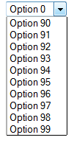
Appendix I: Original Criteria
‹#›
‹#›

Slide 11
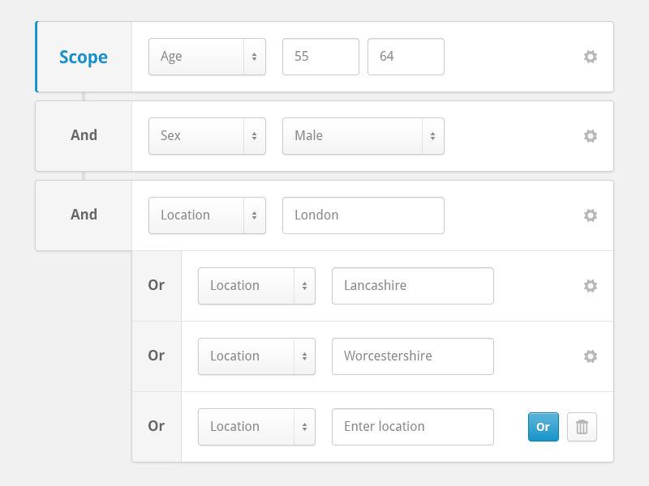
Appendix II: Modular Criteria
‹#›
‹#›

Slide 12
Appendix III: Implementation
Background Information
The Lifion platform is based on metadata architecture.
Every logical flow, user interface, and data model is represented via metadata documents.
Metadata documents contain properties. (eg. Employee: name, role)
Metadata can inherit properties from other metadata documents. (Camry has properties of car)
Inflexible Criteria was built on top of Lifion’s metadata platform.
Each of the thousands of criteria options were represented by separate metadata documents.
Each criteria metadata document inherited from the same parent criteria metadata document.
Each criteria metadata document’s query logic was inflexible and extremely difficult to understand.
Metadata is created and updated via a visual metadata designer experience.
The metadata designer could be used to create any number of custom metadata designers. (Car Factory)
A custom metadata designer can be used to create a corresponding custom metadata definition. (Car)
A custom metadata definition can be used as a baseline to any number of metadata implementations. (Camry)
The design process was a collaborative effort between engineering, design, and product.
‹#›
‹#›

Slide 13
Appendix III: Implementation
Property 1
Property 2
Criteria Designer
creates
implements
Criteria Definition
Metadata Designer
References one of…
references
Inflexible Query
UI Designer
Query Builder Definition
implements
creates
‹#›
‹#›

Slide 14
Appendix III: Implementation
Onboarding Control Center
Query Builder
New Criteria
HR Process X
Client Configuration Control Center
configures
Shows one of…
calls
Dropdown
Existing Criteria
Criteria Service
‹#›
‹#›

Slide 15
Appendix III: Implementation
Implementing Modular Criteria
Updated the criteria metadata document, designer, and service
Engineers can add references to existing property metadata documents (eg. Role, Business Unit) to criteria metadata from the criteria metadata designer
Engineers can flag criteria implementations as “v1” to leverage their existing inflexible queries, or as “v2” to query based on attached property metadata documents
Criteria Service can return filtered query results based on criteria metadata’s attached property metadata documents or existing inflexible queries
Updated the UI metadata document, designer, and service
Engineers can create “Query Builder” metadata (an abstraction of the modular criteria UX)
Engineers can add references to collections of criteria metadata to Query Builder metadata from the metadata designer
UI Platform service can render a Query Builder based on attached collections of Criteria
Updated the onboarding control center interface
Onboarding team can create new criteria based on any property metadata documents in any other criteria via the Query Builder
Onboarding team can select any existing criteria to use in any HR process configuration via Dropdown
‹#›
‹#›

Slide 16
Feature discovery:
Situation:For an all F500 HC solutions company, multiple client was complaining about onboarding times (upto 90 days)
Discovered that the complexity of the platform / waiting for relevant features to be ready to be set up lead to a 90 day onboarding process for any clients using Lifion
Spoke to Dev to ask why features weren’t ready for the onboarding team, discovered Engineers were spending 70% of their dev cycles catching up to the features that marketing/sales inaccurately sold, rather than working on their planned backlog
Marketing/sales team didn’t understand product features, created inaccurate marketing copy and sold features that didn’t exist
Why did they not understand?
The platform configurations were in thousands of complex fixed sets, singular configurations could not be made as the configurations weren’t modular
Task:
Increase user-friendliness of the platform for clients and internal stakeholders
Ideation of the feature
Aggregating desired features / look from interviews with onboarding team / marketing and sales/ clients - finalized that the POC should replace fix-set configurations with modular, single configurations
Built proof of concept (not prototype)
Performed usability testing with onboarding team / marketing and sales / clients on POC, iterate on feedback
Roadmapping
Set timelines, budget/dedicated resources
Engineering manager discussions - could actually replace other parts of our products
Building the feature
Show all the features that it has in a visual
Show building out training capabilities and learning journeys for the clients / onboarding team / marketing and sales
Results
Onboarding time for clients cut more in half
Engineering reduction
Sales & marketing reducing red deals
Lessons learned
Eliminating silos - need to enable communication between sales and development
Iterate fast, fail fast, and learn quickly
Don’t take your clients requests at face value, investigate what they’re really saying

Slide 17
Background context:
Lifion needed to onboard more clients that could spread word of mouth for Lifion
Situation:
The platform configurations were in fixed sets, singular configurations could not be made as the configurations weren’t modular
Resulting problems:
Marketing/sales team didn’t understand product features, created inaccurate marketing copy and sold features that didn’t exist
Engineers were spending 70% of their dev cycles catching up to the features that marketing/sales inaccurately sold, rather than working on their planned backlog
The complexity of the platform lead to a 90 day onboarding process for any clients using Lifion
Task::
Increase user-friendliness of the platform for clients and internal stakeholders, by replacing fix-set configurations with modular, single configurations
Action:
Why: Feature discovery - detectives story that stems from the client (complaining about onboarding)
What: Building / iterating on proof of concept
Aggregating desired features / look from interviews with onboarding team / marketing and sales/ clients
Performed usability testing with onboarding team / marketing and sales / clients, iterate on feedback
Presented proof of concept to executives, explaining what you’d found out from stakeholder interviews
When: Once approval, roadmapping
Set timelines, budget/dedicated resources
Engineering manager discussions - could actually replace other parts of our products
How:
Built the most important features first, adding incremental features as we go
Built out training capabilities and learning journeys for the clients / onboarding team / marketing and sales
Results
Onboarding time for clients cut more in half
Engineering reduction
Sales & marketing reducing red deals
Lessons learned
Eliminating silos - need to enable communication between sales and development
Iterate fast, fail fast, and learn quickly
Don’t take your clients requests at face value, investigate what they’re really saying

